Slide 2
WARM UP:
WHO IS FASTER?

Slide 9
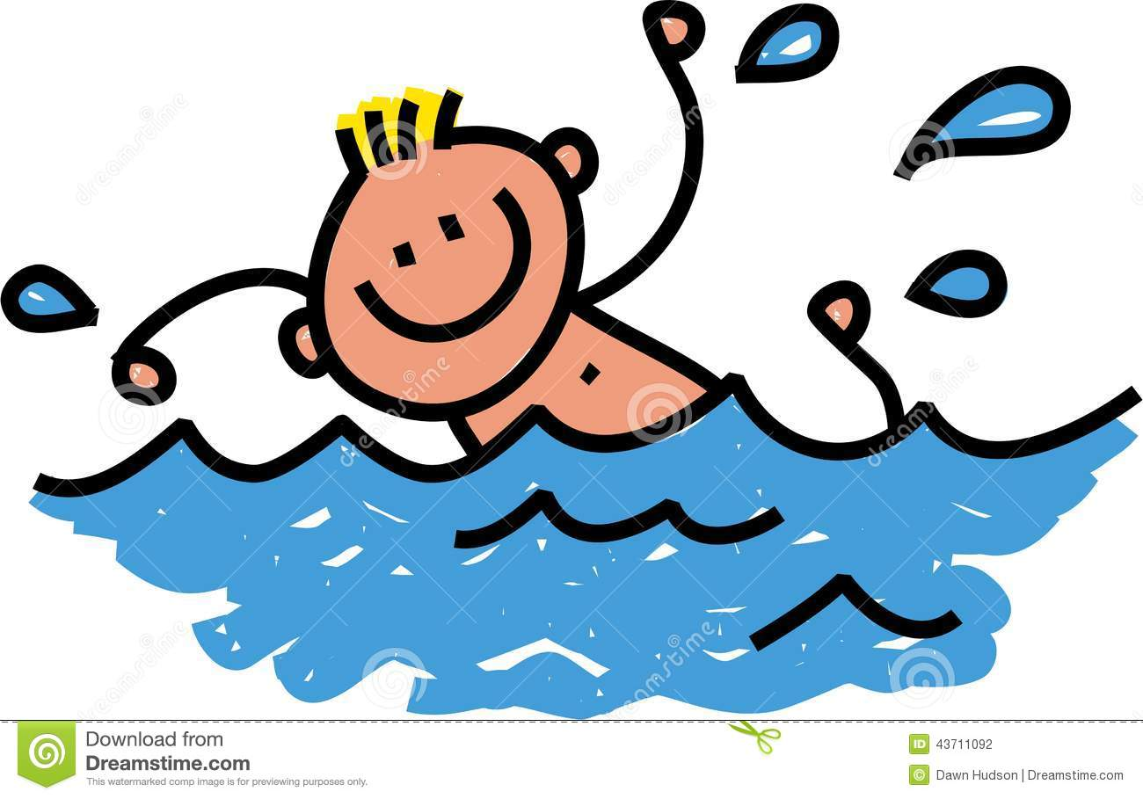
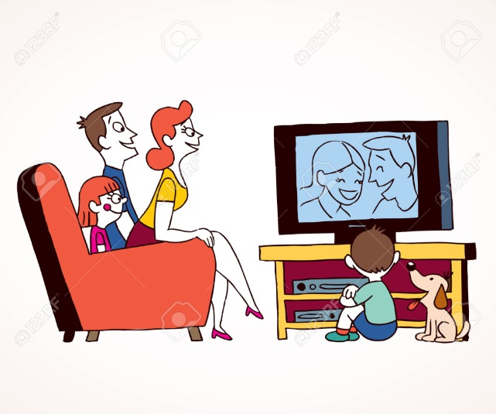
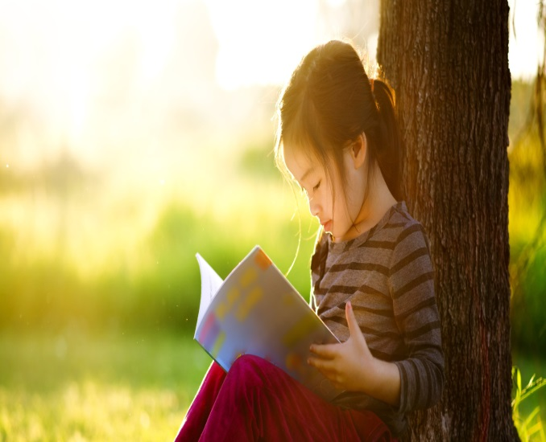
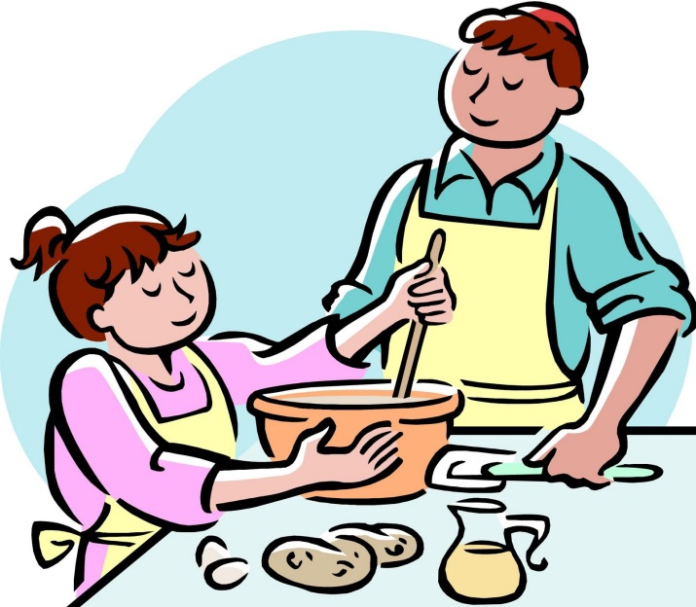
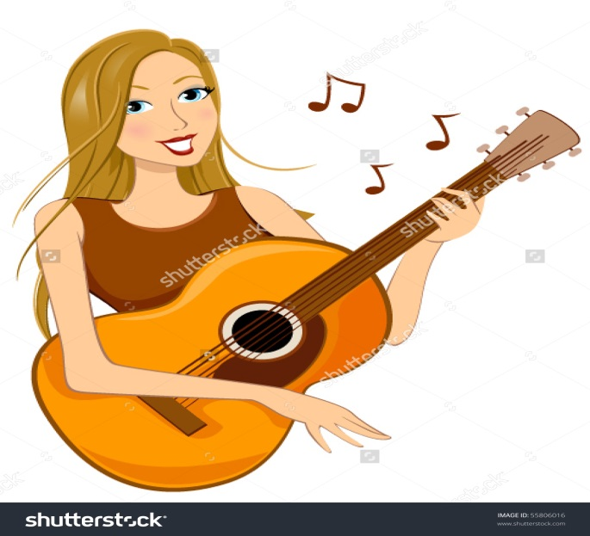
HOBBIES

Slide 10
UNIT 13: HOBBIES
READING

Slide 11
I. BEFORE YOU READ
WHAT DO YOU LIKE TO DO IN YOUR FREE TIME?

Slide 12
II. WHILE YOU READ

Slide 13
1. Scan the words in the passage and complete them.
Each dash ( _ ) is a letter.
1. a_compli_h (v) /əˈkʌmplɪʃ/ : to finish/complete/achieve
=> a_co_pli­_hed (adj.) = skillful/ talented
2. _ccompa_y (v) /ə'kʌmpəni/ : go along with
3. m_des_ (adj.) /'mɔdist/ : simple
4. f_sh ta_k (n) /fi∫ tæηk/ : thing which is used to keep fish in
5. a_id (adj.) /'ævid/ : to be very enthusiastic about something
6. disc_r_ (v) /di,skɑ:d/ : throw away, remove
7. i_dulg_ in (v) /in'dʌldʒ/ : keen on
8. occu_ied (adj.) /'ɒkjʊpaied/ : busy

Slide 14
1. accomplish (v) /əˈkʌmplɪʃ/ : to finish/ complete/ achieve
=> accompli­shed (adj.) = skillful/ talented
2. accompany (v) /ə'kʌmpəni/ : go along with
3. modest (adj.) /'mɔdist/ : simple
4. fish tank (n) /fi∫ tæηk/ : thing which is used to keep fish in
5. avid (adj.) /'ævid/ : to be very enthusiastic about something
6. discard (v) /di,skɑ:d/ : throw away, remove
7. indulge in (v) /in'dʌldʒ/ : keen on
8. occupied (adj.) /'ɒkjʊpaied/: busy

Slide 15
2. Fill in the blanks with suitable
words below:
discard
fish tank
modest
avid
accomplish
1. He has tried very hard to………………..his tasks.
2. Although he is a famous singer, he is very………………
3. Lan keeps her fish in a special…………….
4. Everybody is very…………..to take part in the sport event.
5. They …………...unnecessary things to clear their room.
6. He……………in drinking without conscious awareness of his health.
indulges

Slide 16
3. How many parts are there in the passage?
3 parts: opening, body and closing
Opening: Paragraph 1
Body: 3 paragraphs
- Paragraph 2: Playing the guitar
Paragraph 3: Keeping fish
Paragraph 4: Collecting stamp
Closing: Paragraph 5

Slide 17
4. Answer the following questions
1. What is the writer’s first hobby?
2. Is the writer an accomplished guitarist?
3. Why does the writer admire his uncle?
4. What is the writer’s second hobby?
5. How did he collect his fish?
6. What kind of stamp collector is the writer?
7. Where does he collect his stamp?
8. Which does the writer get more of, local stamp or foreign stamps?
9. What does the writer do with the less common stamps and with the common ones?

Slide 18
What is the writer’s first hobby?
Playing guitar

Slide 19
Is the writer an accomplished guitarist?
No, he isn’t

Slide 20
Why does the writer admire his uncle?
Because he is very good at accompanying people singing with guitar.

Slide 21
What is the writer’s second hobby?
Keeping fish

Slide 22
How did he collect his fish?
Some from the shop and some from the field near his house

Slide 23
What kind of stamp collector is the writer?
He is not an avid stamp collector.

Slide 24
Where does he collect his stamp?
From discarded envelops

Slide 25
Which does the writer get more of, local stamp or foreign stamps?
Local stamp

Slide 26
What does the writer do with the less common stamps and with the common ones?
Less common: keep in a small album
Common: give or throw away

Slide 27
III. AFTER YOU READ
Interview your friends about his/her hobby and
Report the result to the whole class.
Name of your friends
Name of hobby
How often?
When did he/she start?
His/ Her plan for the future

Slide 28
IV. HOMEWORK
Write a short passage about your hobbies
Review all the new words
Prepare Speaking lesson

